Slide 1
Employee Data Analysis using Excel
STUDENT NAME: PUSHPAVALLI. K
REGISTER NO: 312200269 / 18D8A066596F8C09CDA43199EE77CD55
DEPARTMENT: B. COM ACCOUNTING AND FINANCE (3RD YEAR)
COLLEGE: S.I.V.E.T COLLEGE

Slide 2
PROJECT TITLE
Employee salary Analysis using Excel

Slide 3


AGENDA
Problem Statement
Project Overview
End Users
Our Solution and Proposition
Dataset Description
Modelling Approach
Results and Discussion
Conclusion
3/21/2024 Annual Review

Slide 4

PROBLEM STATEMENT “Given a dataset containing employee information, including salary, the objective is to analyze the data to identify trends, disparities, and key factors influencing employee compensation. The goal is to provide actionable insights that can help in optimizing salary structures, ensuring fair compensation practices, and supporting strategic decision-making in HR management.”

Slide 5

PROJECT OVERVIEW
The objective of this project is to organize, analyze, and visualize employee data, including salary details, to support decision-making processes regarding compensation, workforce planning, and performance management

Slide 6

WHO ARE THE END USERS?
Human resources (HR)
Auditor
Employee
Legal and compliance team
Management and executive
Finance department

Slide 7

OUR SOLUTION AND ITS VALUE PROPOSITION
OUR SOLUTION : Our solution provides a comprehensive Excel-based tool for managing and analyzing employee salary data. It is designed to streamline payroll processes, ensure data accuracy, and enhance strategic decision-making. VALUE PROPOSITION : Efficiency and time savings Cost effective solution Data driven decision making Enhanced transparency and compliance Improved employee satisfaction

Slide 8
Dataset Description
When describing employee salary data in an Excel sheet, it’s important to provide clear labels and consistent formatting to make the data easy to understand and analyze. Here’s a typical structure and description of what each column might represent: Employee ID Description: A unique identifier assigned to each employee. Name Description: The first name of the employee. Department Description: The department where the employee works. Salary Description: The annual salary of the employee. Gender Description: The gender of the employee (if applicable). Location Description: The geographical location where the employee is based.

Slide 9

THE "WOW" IN OUR SOLUTION
Visual clues like colour coding to highlight key metrics or critical issues such as employees highest salary list
TOOLS : Conditioning formatting
WOW FACTOR : Make it easy to spot trends and highest to smallest value
3/21/2024 Annual Review
9

Slide 10
MODELLING
PIE CHART:
To show the proportion of total compensation across different departments or role.
CONDITIONAL FORMATTING :
Apply conditional formatting to highlight certain salary ranges.
Eg. Highest salary ranges (more than 1 lakh ) in one colour and lowest range of salary in another colour
10

Slide 11
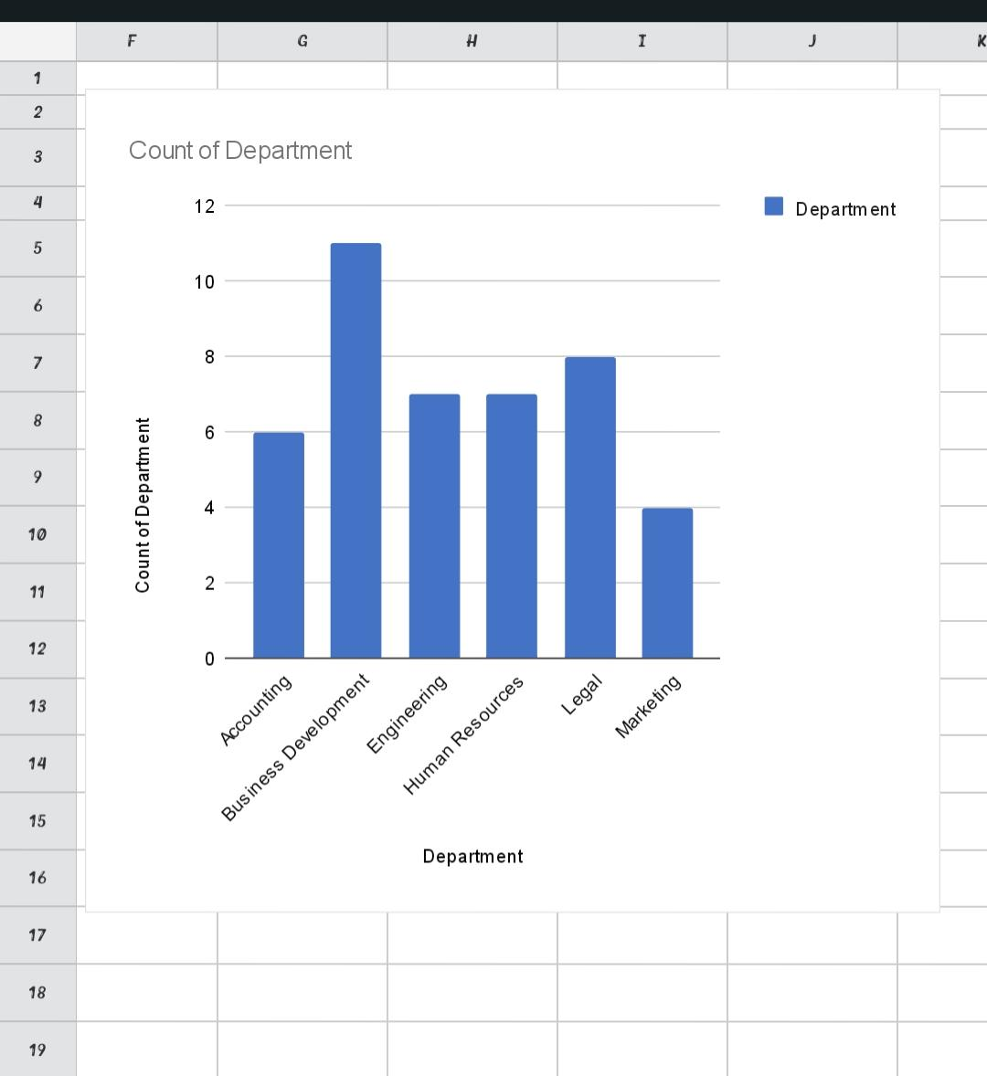
RESULTS
11

Slide 12
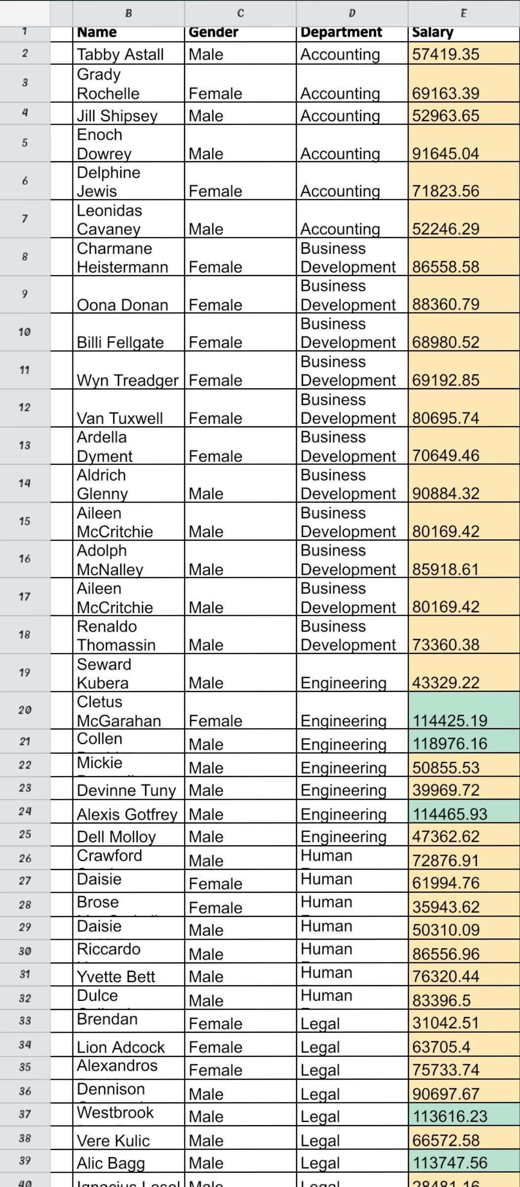

Slide 13
conclusion
Using Excel tools for analyzing employee salary data provides a clear overview of compensation patterns and discrepancies. Features such as PivotTables, charts, and conditional formatting help in summarizing, visualizing, and identifying trends or outliers effectively, leading to informed decision-making.

